Slide 1
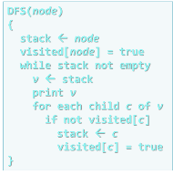
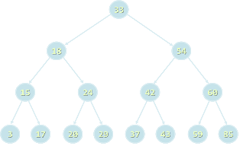

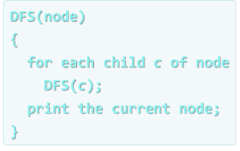


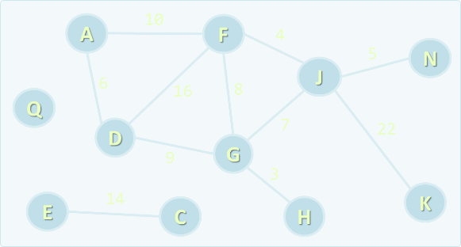
Data Structures
Curriculum, Trainers, Evaluation, Exams
Data
Structures
SoftUni Team
Technical Trainers
Software University
http://softuni.bg

Slide 2

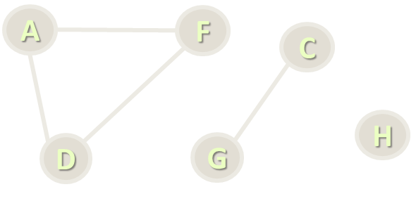
Table of Contents
Course Objectives
Course Program
Trainers Team
Examination
Learning Resources

Slide 3

Data Structures
Course Objectives & Program

Slide 4
Part I: Data Structures – Course Program
Course Overview
Data Structures, Algorithms and Complexity
Linear Data Structures – Lists
Linear Data Structures – Stacks and Queues
Trees and Tree-Like Structures
Tree Traversal Algorithms – BFS and DFS
Dictionaries and Hash Tables

Slide 5
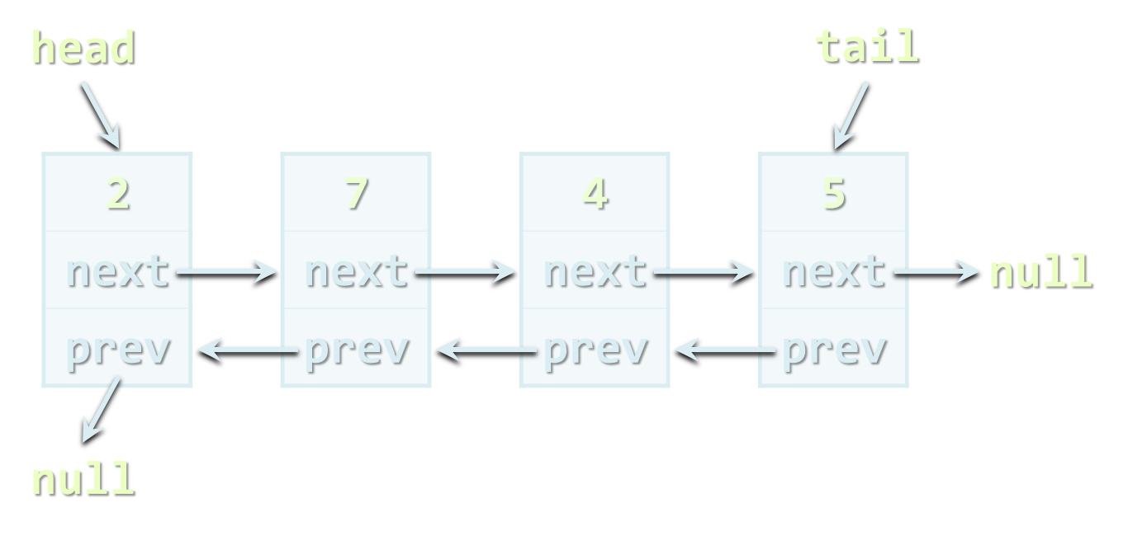
Part I: Data Structures – Course Program (2)
Data Structure Collections and Libraries
AVL tree, B-tree, Red-Black tree
Rope, k-d Trees, other tree structures
Data Structure Efficiency
Exam Preparation
Practical Exam

Slide 6

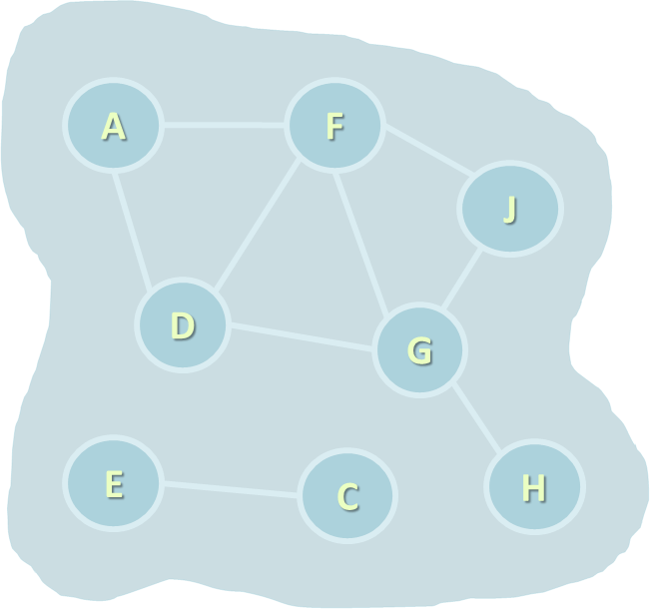
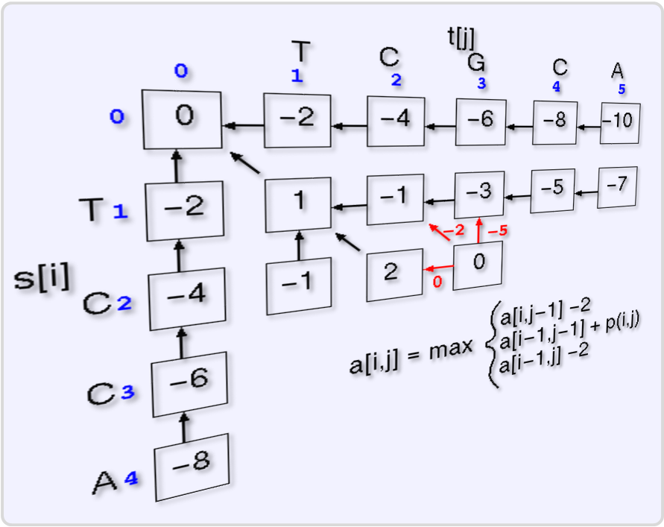
Part II: Algorithms – Course Program
Recursion and Recursive Algorithms
Combinatorial Algorithms
Sorting and Searching Algorithms
Dynamic Programming
Graphs and Graph Algorithms
Parallel Processing and Map-Reduce
Problem Solving Methodology
Exam Preparation
Practical Exam

Slide 7

The Trainers Team

Slide 8

Trainers Team
Atanas Rusenov
Technical Trainer @ Software University
Top performing student from the Software University (2014)

Slide 9
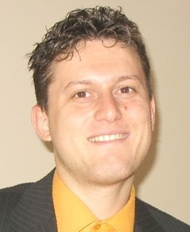
Trainers Team
Svetlin Nakov, PhD
Training & Inspiration Manager @ Software University
20+ years software development experience
10+ years experience as trainer
Author of 7 programming books
Winner in International programming contests and Olympiads
Speaker at hundreds of events
Web site & blog: www.nakov.com

Slide 10

Data Structures: More Details
Duration, Course Format, Languages

Slide 11


Training Duration – Data Structures
Lessons: ~ 20 hours (onsite + YouTube videos)
Practical exercises (in class): ~ 20 hours
Lab: 4 hours
Exam preparation: 4 hours
Homework: ~ 30-50 hours
Schedule: Feb – March 2016
Practical exam: 27 March 2016

Slide 12
Programming Languages
Course attendees can use their favorite programming language:
C#, Java, C++, Python / other
The recommended language for this course is C#
Exercises in class assume you will write in C# + Visual Studio
Labs and examples will also focus mostly on C# and Visual Studio
At the final exam attendees can use:
C# or Java

Slide 13



Why English?
Why the slides are in English?
English is the native language of the software engineers
Specific terminology should be in English
Translations are inaccurate and funny
Just learn English!
No excuses

Slide 14



Data Structures
Evaluation Criteria

Slide 15
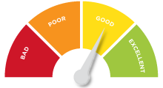

Scoring System for the "Data Structures"
Practical exam
90%
Homework + evaluation
5% + 5%
Contribution in the forum:
up to 10% bonus

Slide 16


Data Structures – Practical Exam
The practical exam tests your skills to design, implement and use data structures efficiently
1 problem for 6 hours
Command execution system
E.g. add + edit + remove tickets + search
E.g. add + extract-min + extract-max
Available unit tests to test solution with real-time feedback

Slide 17

Homework Assignments
Doing your homework is very important!
Programming can only be learned through a lot of practice!
You should write code every day!
Each lecture is followed by a few exercises
Try to solve them in class
The rest are your homework
Homework assignments are due in 1-2 weeks after each lecture
Submission will be accepted through our web site: softuni.bg

Slide 18


Homework Peer Reviews
Give feedback to a few random homework submissions
Students submit homework anonymously
Please exclude your name from the submissions!
For each homework submitted
Students evaluate 3 random homeworks
From the same topic, after the deadline
Give written feedback, at least 200 characters
Low-quality feedback → report for punishment
Everyone will get feedback for their homework

Slide 19









Resources
What We Need Additionally?

Slide 20

Course Web Site & Forums
The Data Structures course official Web site:
Register for the "Software University Forum":
Discuss the course exercises with your colleagues
Find solutions for all course exercises and labs
Share source code / discuss ideas / help each other
https://softuni.bg/trainings/1308/data-structures-february-2016
https://softuni.bg/forum

Slide 21



Data Structures Slides and Videos
All lecture slides, videos, homework assignments, labs and other resources are open content, available for free
Visit the course web site to access the course resources

Slide 22


Data Structures – Additional Resources
Nakov P., Dobrikov P., "Programming = ++ Algorithms;", 5th Edition, ISBN: 954-8905-06-X, Faber Publishing (2015)
Download a free copy from: www.programirane.org
No English version (Bulgarian only)
Cormen T., Leiserson C., Rivest R., Stein C., "Introduction to Algorithms", 3rd Edition, ISBN 978-0262033848, MIT Press (2009)
Find the book in Internet: https://goo.gl/ElgQD3

Slide 23
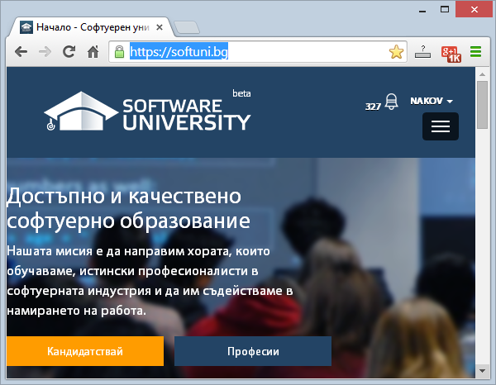
Software University Learning System (SULS)
Software University Learning System (SULS)
www.softuni.bg
Important resources for students
Homework submissions
Homework check-up
Exams and results
Discussion forum
Reports about your progress

Slide 24
Recommended Software
Visual Studio Community 2013
Or other C# development environment
SharpDevelop – lightweight IDE for C#
Xamarin Studio – powerful IDE for C# / .NET for Linux, Mac OS X, Windows and others
Wintellect Power Collections
https://powercollections.codeplex.com
Eclipse / IntelliJ IDEA (for Java), Code::Blocks (for C++)

Slide 25








Data Structures Course Introduction
https://softuni.bg/trainings/1308/data-structures-february-2016

Slide 26
License
This course (slides, examples, labs, videos, homework, etc.) is licensed under the "Creative Commons Attribution-NonCommercial-ShareAlike 4.0 International" license
Attribution: this work may contain portions from
"Fundamentals of Computer Programming with C#" book by Svetlin Nakov & Co. under CC-BY-SA license
"Data Structures and Algorithms" course by Telerik Academy under CC-BY-NC-SA license

Slide 27






Free Trainings @ Software University
Software University Foundation – softuni.org
Software University – High-Quality Education, Profession and Job for Software Developers
softuni.bg
Software University @ Facebook
facebook.com/SoftwareUniversity
Software University @ YouTube
youtube.com/SoftwareUniversity
Software University Forums – forum.softuni.bg

